Slide 1
Review Classification using Convolution Neural nets Master’s Project
Varun Negandhi
vsngndhi@memphis.edu

Slide 2

Agenda
Problem Statement
Working with text
Universal Sentence Encoder
Baseline models
Disadvantage with baseline
Proposed Approach
Convolutional neural network
Experiment results
Future Work

Slide 3
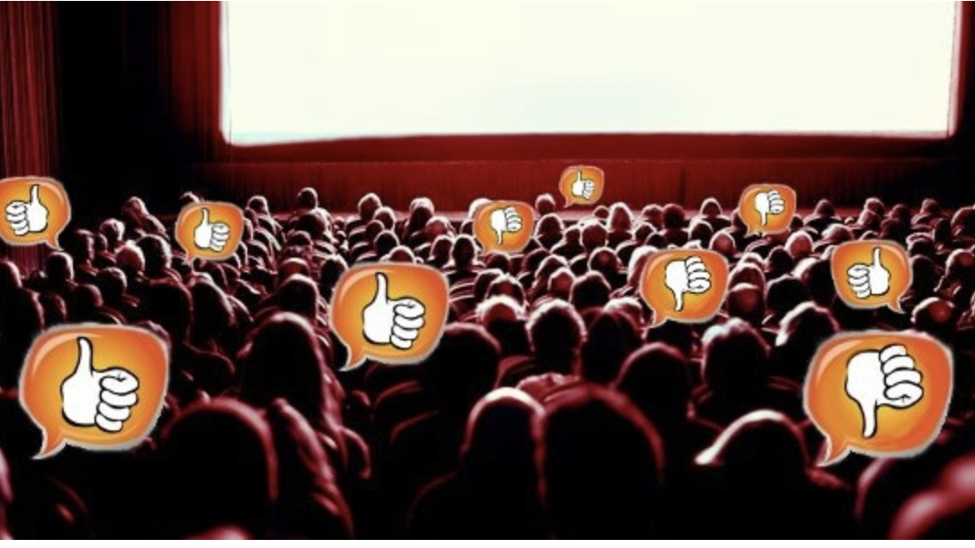
Problem Statement
Given an IMDB review dataset, identify whether the review text is positive or negative using
Convolutional Neural Network

Slide 4
Why convert text to vectors?
The review length is not the same for all reviews
Once converted to vectors, the distance between these points can be calculated to determine which texts are similar.
Notes:
Converting word to six dimension which covers the context of the sentence. Adding vectors will not work because it has sequence to follow.

Slide 5
Embedding texts
Word embedding and sentence embedding are different
Sentence embedding cannot be derived from word embeddings directly
Google’s Universal Sentence Encoder

Slide 6
Universal Sentence Encoder
Embedding mechanism from Google.
Deep learning model trained on data from number of sources
Available in 2 architectures – Tranformer and Deep Averaging Network (DAN)
In this project, converts each review into a vector of 512 features.

Slide 7
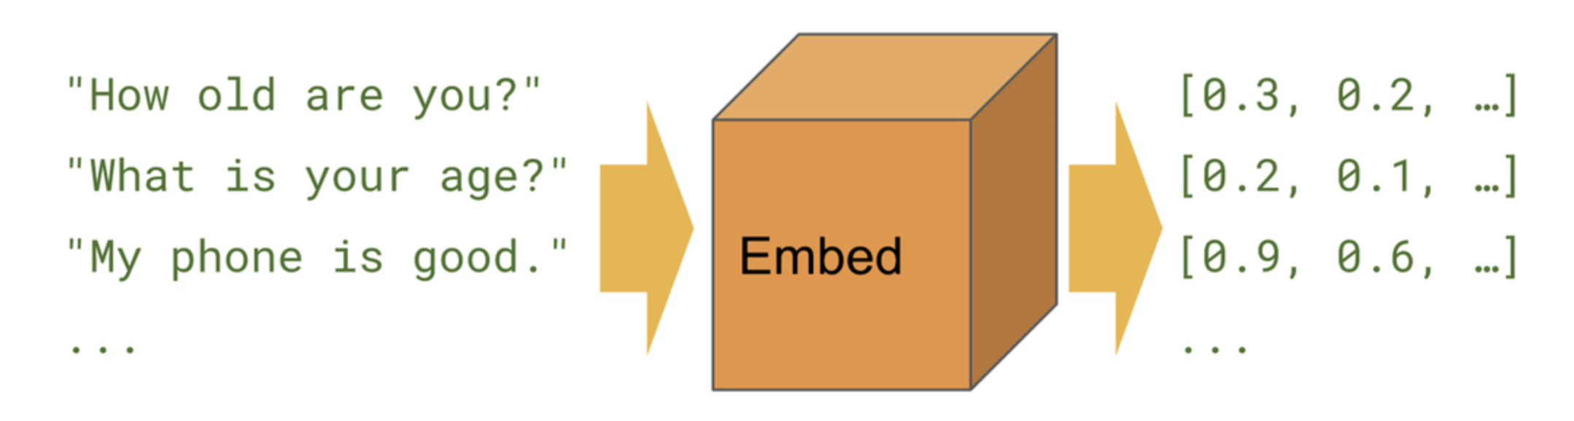
Why Universal Sentence Encoder?
The first 2 sentences are similar and the third one is different
It considers the relational meaning of the word, sentence or paragraph

Slide 8
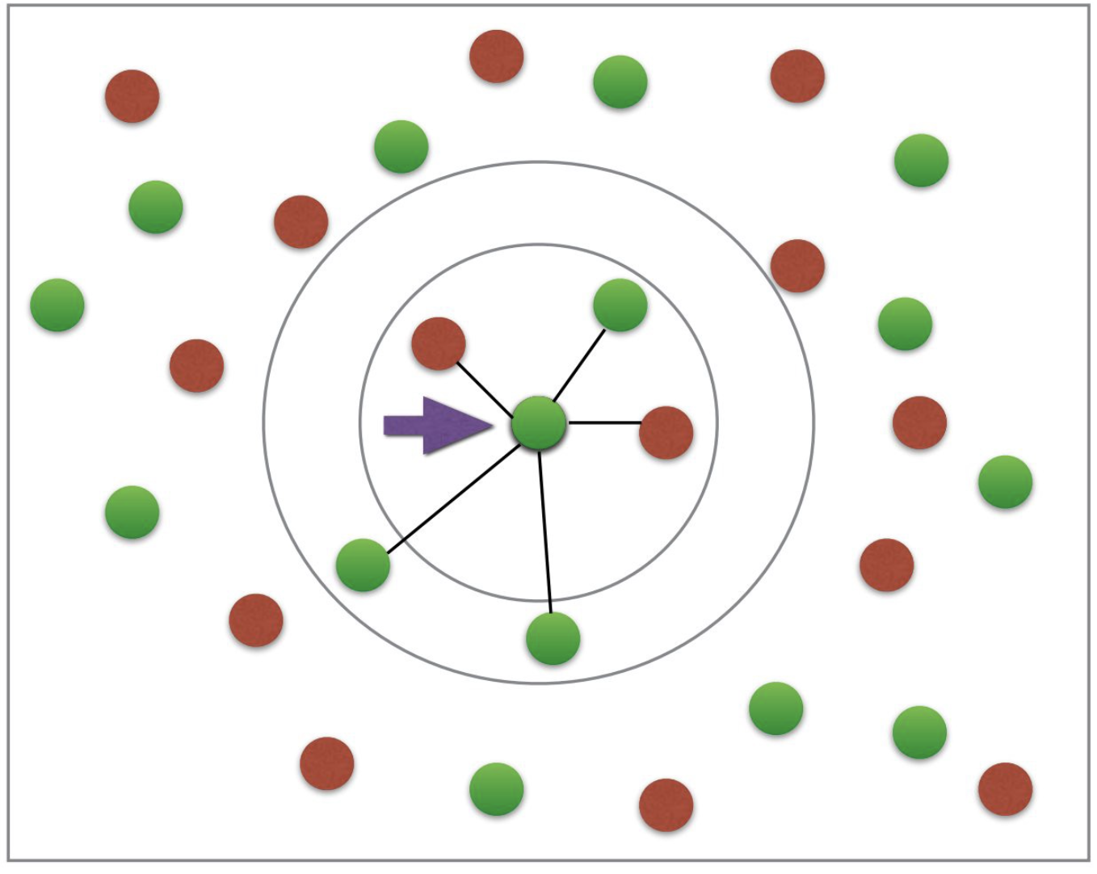
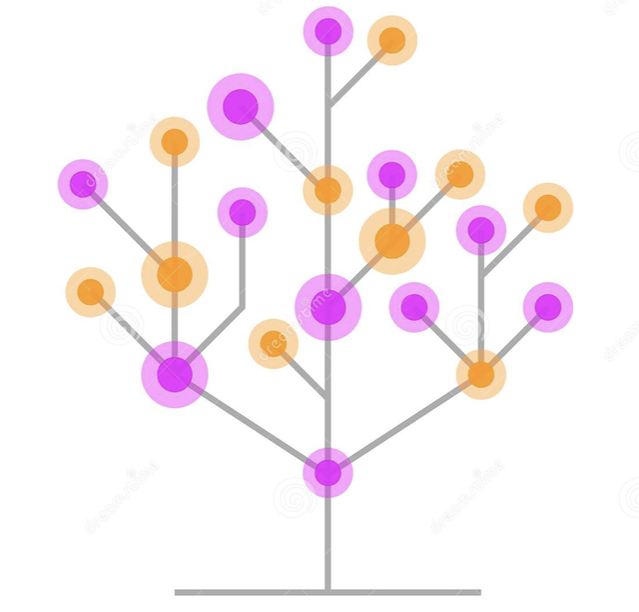
Baseline models
K Nearest Neighbor
(Voting based approach
From its nearest elements)
Decision Tree
(Each leaf is target label
and branches are feature values)
Notes:
KNN instance based and Decision trees rule based models. Different decision families. Function based families comparision

Slide 9
Baseline model results
K-Nearest Neighbor
Decision Tree
 | Precision | Recall | F1-Score | Support
Negative | 0.83 | 0.80 | 0.82 | 8208
Positive | 0.81 | 0.84 | 0.83 | 8292
Accuracy |  |  | 0.82 | 16500
Macro avg | 0.82 | 0.82 | 0.82 | 16500
Weighted avg | 0.82 | 0.82 | 0.82 | 16500
 | Precision | Recall | F1-Score | Support
Negative | 0.74 | 0.75 | 0.74 | 8208
Positive | 0.75 | 0.74 | 0.74 | 8292
Accuracy |  |  | 0.74 | 16500
Macro avg | 0.74 | 0.74 | 0.74 | 16500
Weighted avg | 0.74 | 0.74 | 0.74 | 16500

Slide 10
Disadvantage of KNN
Lazy learning model - Does not learn a model or functions
It gives result based on majority of the neighboring element labels
Notes:
Lazy learning model. Does not learn functions . Idea of neighborhood is good. If embedding is perfect, then you can use it. If not it as a neighborhood as correction – Robustness of embedding. But embedding is approximate method

Slide 11
What do we know ? What have we learnt?
KNN is lazy method of prediction but the concept of neighborhood is good.
Embedding is an approximation method and hence not perfect representation of text
So we combine similar review texts to get a general context we may smooth this embedding error if any.
Let’s have a look…

Slide 12
Proposed approach:
Use cosine similarity to form neighborhood matrix for each review
Identify 25 closest reviews for each review in the data
Use this matrix as input to Convolutional Neural Network
Tune parameters of deep learning model
Control overfitting
Use model on test data

Slide 13
Forming Neighborhood example
Great for kids. I love that I can monitor my kids
This is my first tablet. It's very user friendly. Like the parental controls on it. So my kids can use it
This product so far has not disappointed. My children love to use it and I like the ability to monitor control what content they see with ease.
Cosine Similarity
I love this table because I can monitor everything my kids download!!! Watch!!! Use!!!! I can control everything!!! Best investment!!!
For each review, the neighborhood contains 25 similar reviews. Hence the dimension of every row
of data becomes (25, 512)

Slide 14
Forming Neighborhood example
Example review
Probably my all-time favorite movie, a story of selflessness, sacrifice and dedication to a noble cause, but it's not preachy or boring. It just never gets old, despite my having seen it some 15 or more times in the last 25 years. Paul Lukas' performance brings tears to my eyes, and Bette Davis, in one of her very few truly sympathetic roles, is a delight. The kids are, as grandma says, more like "dressed-up midgets" than children, but that only makes them more fun to watch. And the mother's slow awakening to what's happening in the world and under her own roof is believable and startling. If I had a dozen thumbs, they'd all be "up" for this movie.
Probably my all-time favorite movie, a story of selflessness, sacrifice and dedication to a noble cause, but it's not preachy or boring. It just never gets old, despite my having seen it some 15 or more times in the last 25 years. Paul Lukas' performance brings tears to my eyes, and Bette Davis, in one of her very few truly sympathetic roles, is a delight. The kids are, as grandma says, more like "dressed-up midgets" than children, but that only makes them more fun to watch. And the mother's slow awakening to what's happening in the world and under her own roof is believable and startling. If I had a dozen thumbs, they'd all be "up" for this movie.
Cosine similarity = 1.0000
This movie is brilliant in every way. It touches on the complexities of loving relationships in a meaningful way, but never lectures. The script never condescends toward any character, not even the hapless Johnny. It also and benefits from spot-on direction, production design, casting, and performances. The fact that Cher is so perfect in
the film and is more unlike "Cher" than she has ever been is a wonder to me. I watch Moonstruck at least once a year and I just viewed it again this Christmas eve with my 16 year old twin daughters and they loved it as well. It has something for everyone with a heart and leaves you filled with joy in the end.
Cosine similarity = 0.8495669
Original Embedding:
[-0.02724895 0.00743809 -0.00618643 ... -0.00343892 0.00357993
0.03877556]
Neighborhood matrix:
[[-0.02724895, 0.00743809, -0.00618643, ..., -0.00343892, 0.00357993, 0.03877556],
[ 0.01704155, 0.04490056, -0.00240944, ..., -0.03973788, -0.01330681, 0.00876388]]
Neighborhood matrix Shape : (1, 2, 512)

Slide 15
Deep learning model
In this project, we use convolutional neural networks(CNN)
CNNs include functions relate to the neighbors in a group
Since we are working with neighborhood texts, CNN provide a good option

Slide 16
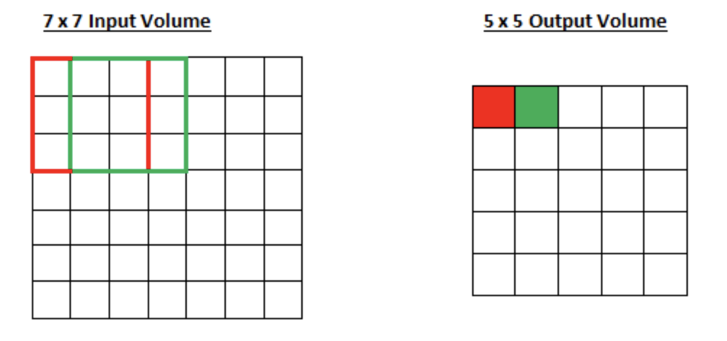
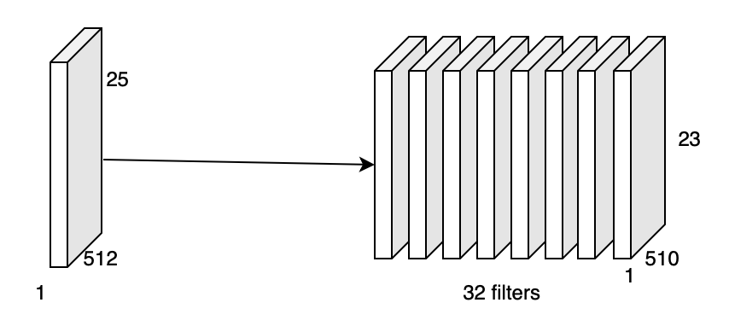
Convolutional Neural Network
a) Convolutional2D Layer – Dot product of the input with kernel
Convolution Example
Convolution input and output for the project
Notes:
Why CNNs? Find functions that relate neighborhoods together. CNNs because we can learn neighborhoods together.

Slide 17
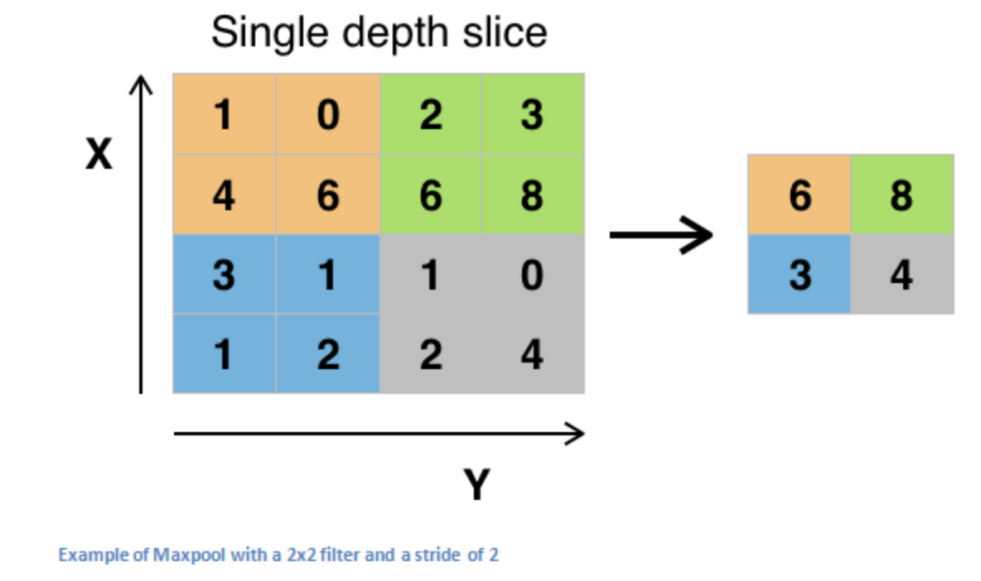
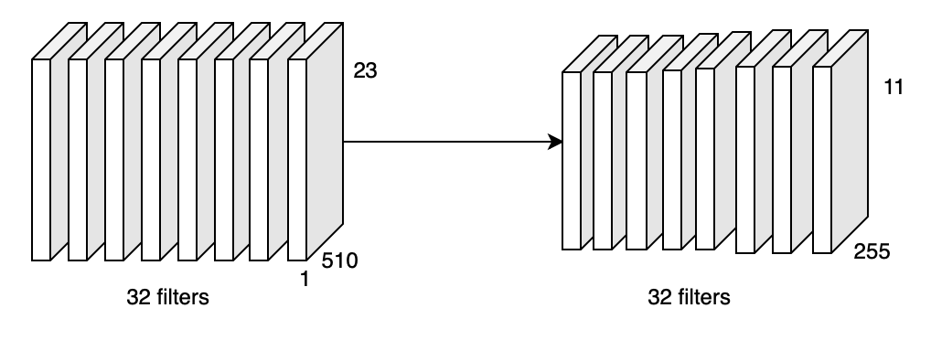
Convolutional Neural Network
b) MaxPool Layer – Choose maximum number from filter of fixed size
MaxPool Example
MaxPool input and output for the project
Notes:
Mention that it reduces dimensions

Slide 18
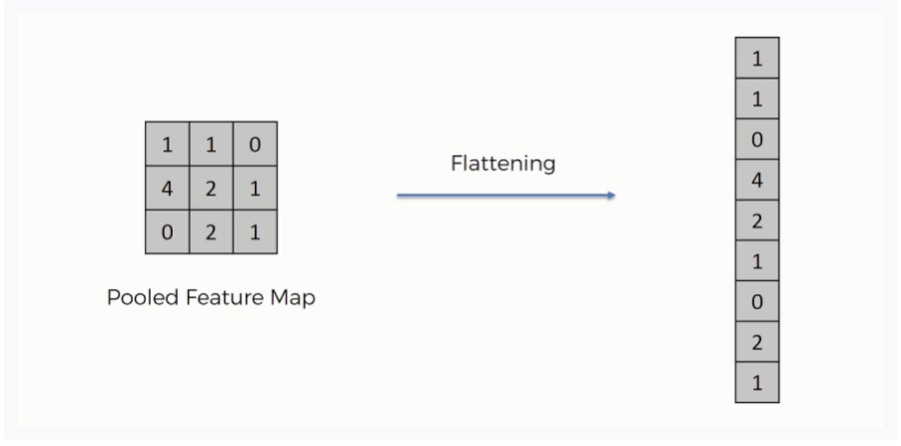
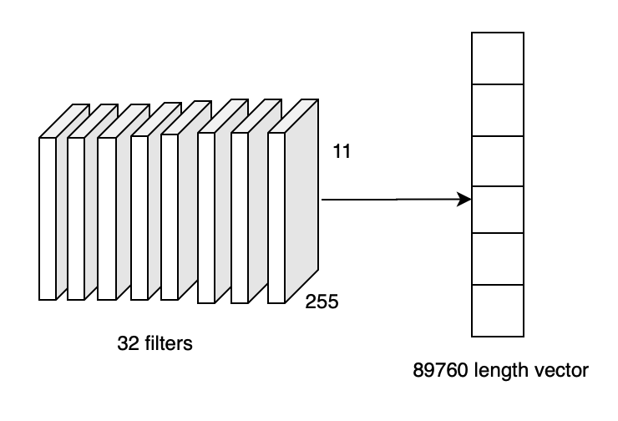
Convolutional Neural Network
c) Flatten Layer – Converts input into long vector to add as input to neural network
Flatten Example
Flatten input and output for the project

Slide 19
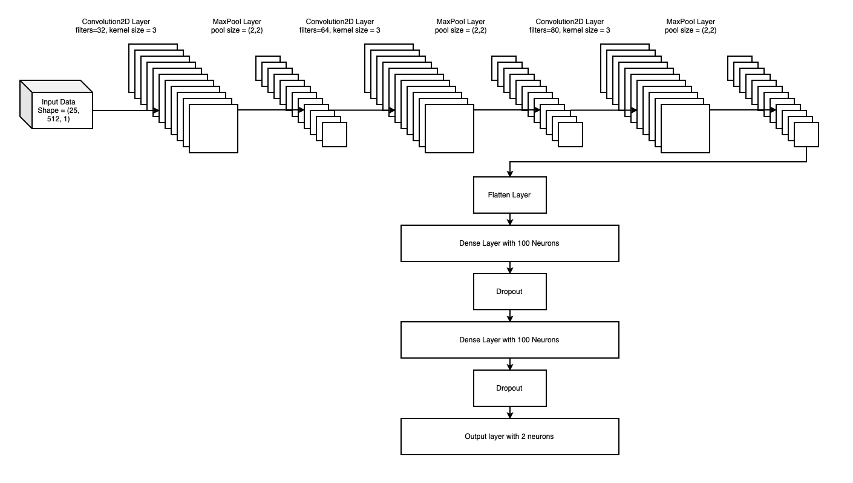
CNN Architecture Diagram

Slide 20
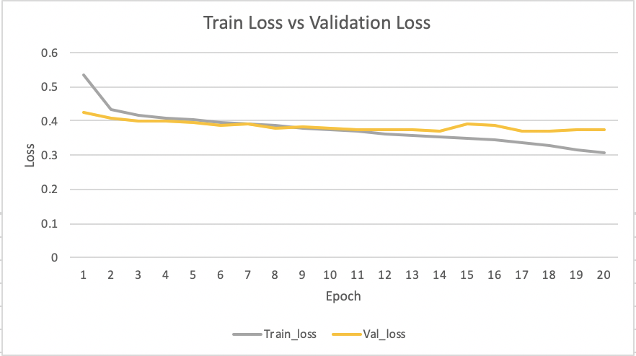
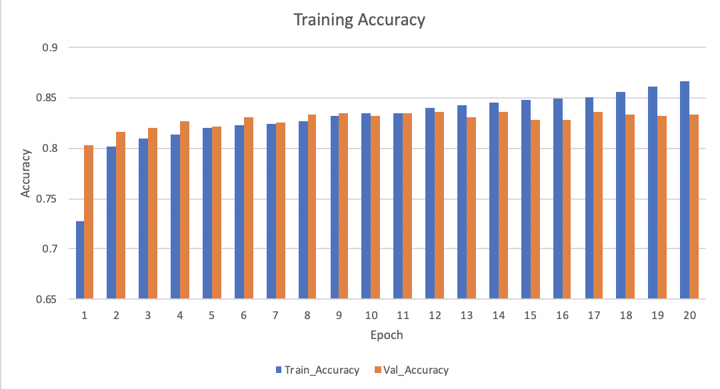
Dropout layer to avoid overfitting
Loss – Train vs Validation data
Accuracy – Train vs Validation data

Slide 21
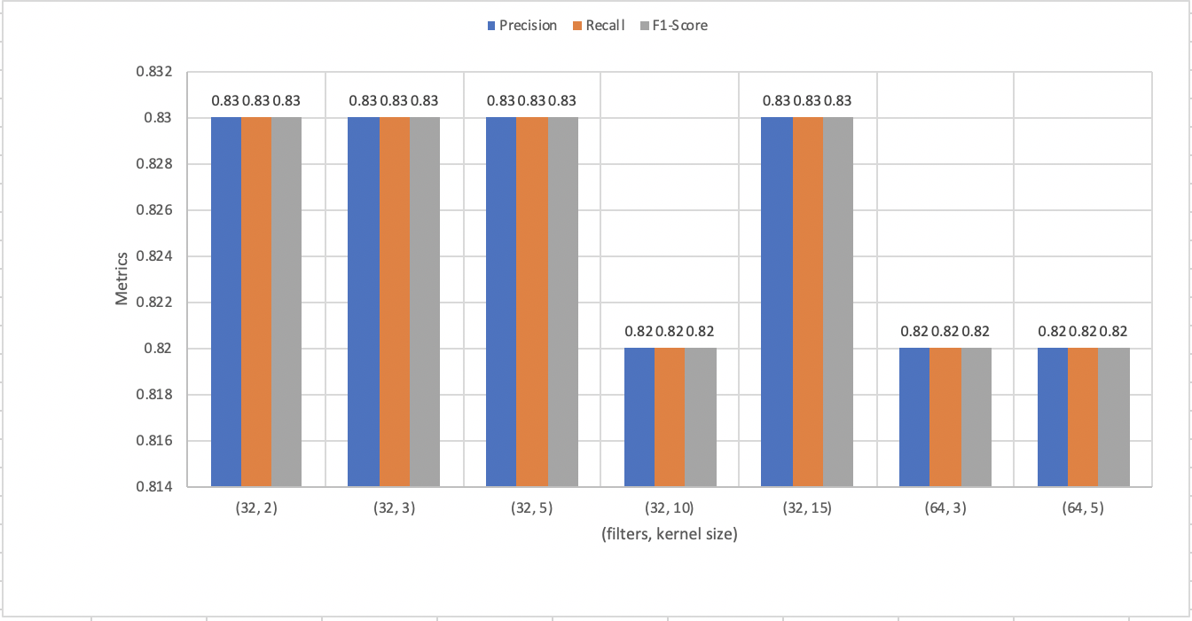
Experiment with conv and maxpool layer

Slide 22
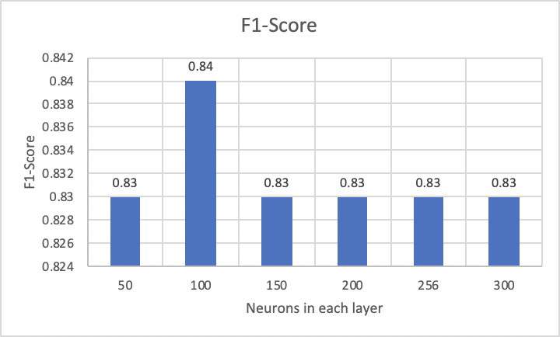
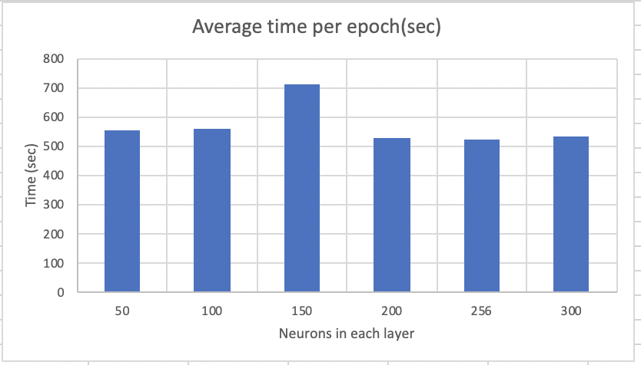
Experiment with Neurons
F1-Score
Average time per epoch (sec)
Tools: The hardware used is laptop with 2.3 GHz Quad-Core Intel Core i5 processor.

Slide 23
Final results:
Table 6. Classification report for the model
Epoch = 20
Batch Size = 1000
Loss = binary crossentropy
 | Precision | Recall | F1-Score | Support
Negative | 0.83 | 0.85 | 0.84 | 8208
Positive | 0.84 | 0.81 | 0.84 | 8292
Accuracy |  |  | 0.84 | 16500
Macro avg | 0.84 | 0.84 | 0.84 | 16500
Weighted avg | 0.84 | 0.84 | 0.84 | 16500

Slide 24
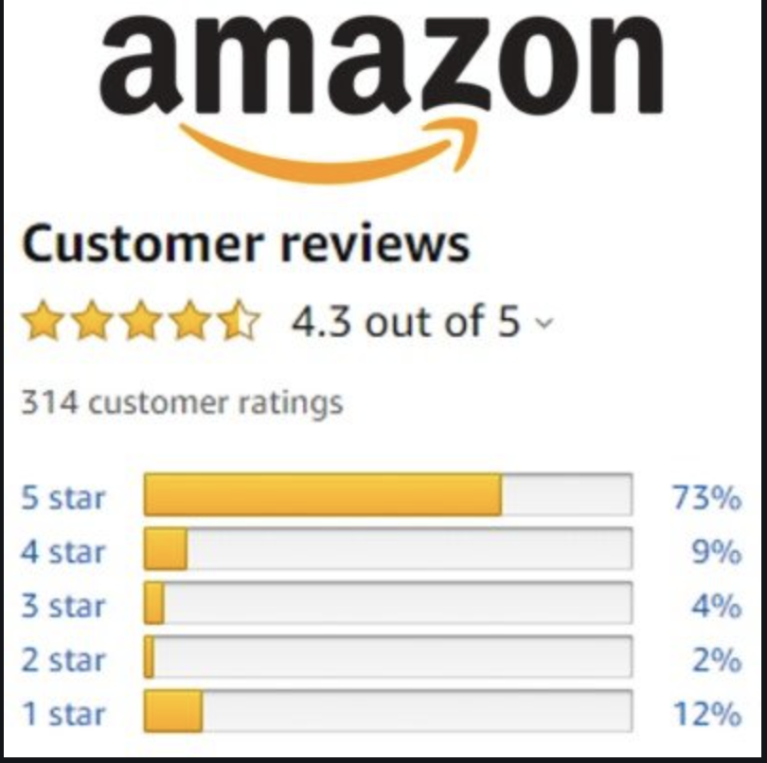
Applying this approach on multiclass problem:
Rating Score | Number of rows
1.0 | 410
2.0 | 402
3.0 | 1499
4.0 | 8541
5.0 | 23775
The F1-Score for this dataset was 67%
Reason:
1. Class imbalance
2. Very difficult to understand scores
Notes:
Harder problem to solve. Issues with multiclass. Text data and user data for multiclass for powerful class. Different slide. Conclusion summary slide. Time series(time of review) use LSTM models.

Slide 25
Future Work: Working on multiclass data
The Amazon dataset has many columns like review texts, review scores, review date, review username and lots more.
The neighborhood can have 2 set of filters – first find similar review texts and then filter by similar username
One could form a time series with the time when the user posted review and thus form a sequence. Then use LSTM models

Slide 26
Summary
The Universal Sentence Encoder captures relational meaning between sentences and hence effective
The baseline models present F1-Scores as 74 for Decision Tree, 82 for KNN whereas neighborhood approach presents F1-score as 84
This concept can be applied to multiclass classification but requires more effort with the neighborhood and experimentation

Slide 27
Thank you

